Slide 1
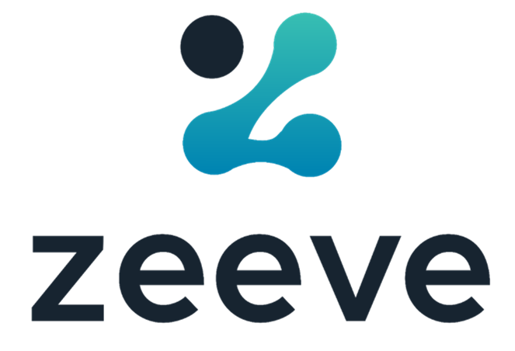
ENTERPRISE BLOCKCHAIN
Cost of Ownership
Ghan Vashishtha (Co-Founder & CTO - Zeeve)

Slide 2
This series will educate us about
High level Construct of an Enterprise Blockchain solution.
Relevant factors that affect the costs.
Why transaction size and volume are important determinants?
What are the objectives of the organization to be met?
Node Management and cost perspective.
How is the choice of a node deployment platform critical in determining the total cost of the enterprise blockchain implementation?
Blockchain Investment
CAGR (2019-27)

Slide 3
Cost of Setup
Private Blockchain cost model and scenario
5
A general cost model can be reasonably constructed using the assumptions and inputs previously discussed. To demonstrate the costing methodology. See the example scenarios below. Which are based on inputs, assumptions and outputs incorporated in the model framework. Costs are separated into four major categories, with many declining over time in accordance with the experience curve
Inputs
Scenario 1
Scenario 2
Scenario 3
Scenario 4

Slide 4
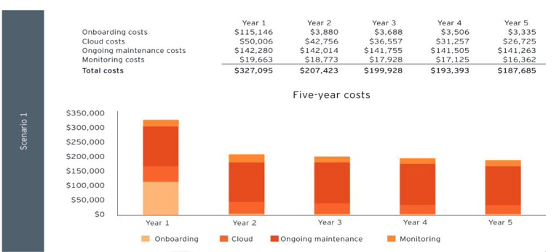
Scenario 1

Slide 5
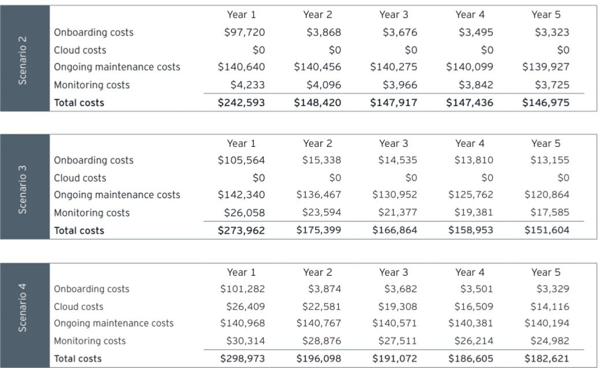
Scenario 2
Scenario 3
Scenario 4

Slide 6
5
Key Inputs
There are additional inputs to consider, but for the purpose of simplicity and standardization, only the most influential are highlighted here:
Transaction volume
Transaction size
Node hosting method
Consensus protocol
Monitoring and SLA Management

Slide 7
Transaction Volumes
Transaction volume relates to the amount of activity performed on a blockchain. Transaction volume requirements determine the scalability characteristics a blockchain solution should possess for particular use cases .
Each transaction impact resources including compute, storage, and network I/O.
How we do
With Zeeve
Transaction Size
Transaction size refers to the storage requirements for one unit of value transacted on the network. Transaction size primarily impacts, among others, transaction review and audit costs.
Blockchain protocols have varying transaction sizes because of the difference in their target use cases and the architecture they have.

Slide 8
Node Management Method
The node hosting method refers to the chosen method for managing a blockchain solution and all of its ancillary technological requirements.
The three most common stand-alone methods are on-premises and cloud-based.
Hosted Cloud
Existing cloud partnership.
Automation or Manual

Slide 9
5
Consensus Protocol
Consensus protocol refers to the method of verifying the legitimacy of blocks of transactions. The following consensus protocols are utilized by both public and private blockchains:
Proof of work uses a large amount of computing power to mine blocks of transactions.
Proof of stake uses financial assets as an incentive to mine blocks with integrity.
Proof of authority allocates the responsibility or verifying blocks to specified participants.
Byzantine fault tolerance employs a voting system, Usually within private blockchains, through which consensus Is met once identical responses are received from trusted nodes.

Slide 10
Considerations
Any cost forecasting mode will depend on assumptions and benchmarking data until enterprise blockchain data becomes more readily available.
Applications become more standardized, and pricing becomes more consistent .
There is a wide range of possible use cases for blockchain technology. Different applications will have specialized technological governance and regulatory requirements .
As an example, an application to track derivatives trades Is expected to have higher quality assurance costs than a platform to send micro-payments directly to developers

Slide 11
Is your Blockchain DevOps Cost as high as number of Nodes in your Blockchain Network?
Talk to Zeeve Experts today to increase ROI and achieve faster time to market for all your Blockchain solutions

Slide 12
Address
Zeeve Deeptech Pvt Ltd 1283, ATS Greens, Sector-93A Noida, India 201304
Zeeve Technologies Ltd.
2001, Regal Tower, Business Bay, Dubai, UAE
Zeeve Inc. 395 Santa Monica Place, Unit 308, Santa Monica, California - 90405
USA
Dubai
India
Contact
Email: success@zeeve.io
http://www.zeeve.io

